Slide 1






AUTOMOBILE INSURANCE COMPLAINTS RANKINGS
Submitted By - Akash Narendra Wahane Aaspruha Dash
Chinmay Bonde
Ayush Munjewar

Slide 2









CONTENT INDEX
Project Description
Complaint Diagnostic Report Diagnostic Analysis
Progress of Premiums Over the Years
Causes of the Progress of Premiums
Comparison Report Recommendations

Slide 3



PROJECT DESCRIPTION
The project analyzes ranks automotive insurers based on complaint data, offering insights for improvement and fostering transparency in the industry.

Slide 4


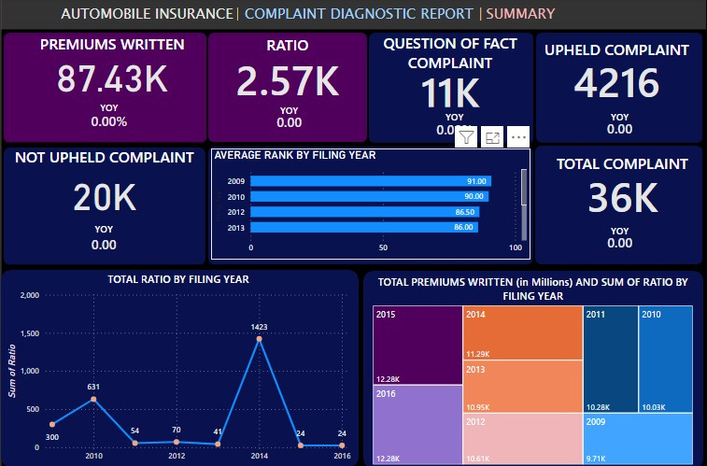
Complaint Diagnostic Report
This diagnostic report shows complaint data of automobile insurance companies provided by the DFS. The report focuses on understanding the nature of complaints, their resolution, and the factors influencing complaint ratios.

Slide 5

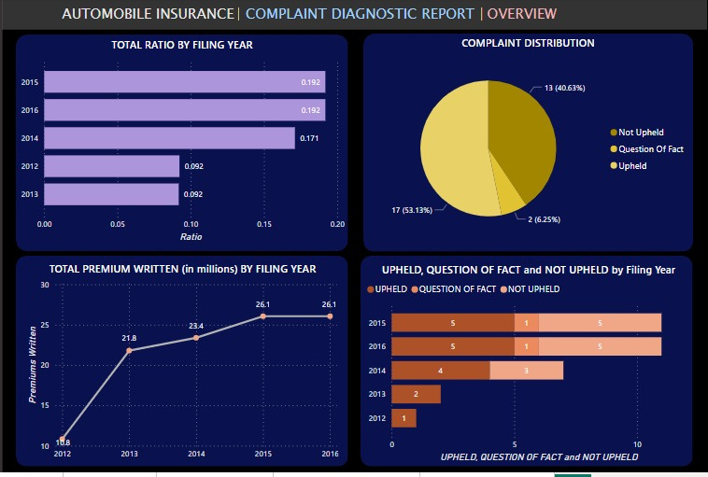


Slide 6



Diagnostic Analysis
Complaint Ratio Analysis:
New Hampshire Insurance Company, Clarendon National Insurance Company, and Victoria Fire & Casualty Company are some organizations with the highest complaint ratios, indicating potential problems in claim handling or customer service.
Organizations with high complaint ratios have lower ranks, and vice versa.
Upheld Complaint Analysis:
Out of 4216 upheld complaints, Long Island Insurance Company had the most complaints and a lower rank too.
Allstate Insurance Company also had a higher number of upheld complaints from 2009 to 2014. This reflects that many companies are responsible for customer grievances.

Slide 7



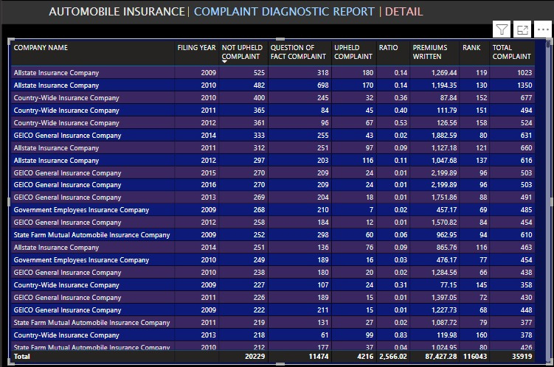


Diagnostic Analysis
Question of Fact Complaints:
A total of 11474 question of fact complaints were registered, and Allstate Insurance Company had around 698 complaints.
A large number of these complaints show the need for better communication and clarity in policy terms by the organizations involved.
Not Upheld Complaints:
Most companies that have higher not upheld complaints also have higher question of fact complaints.
A total of 20229 not upheld complaints were registered, and seven companies had more than 300 such complaints.

Slide 8



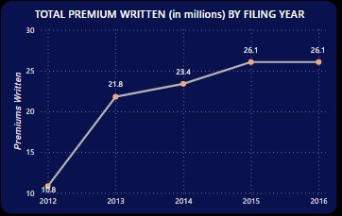
Progress of Premiums Over the Years
The progress of premiums from 2009 to 2016 provides valuable insights into the automobile insurance industry's dynamics. It helps to find patterns and make informed decisions.

Slide 9


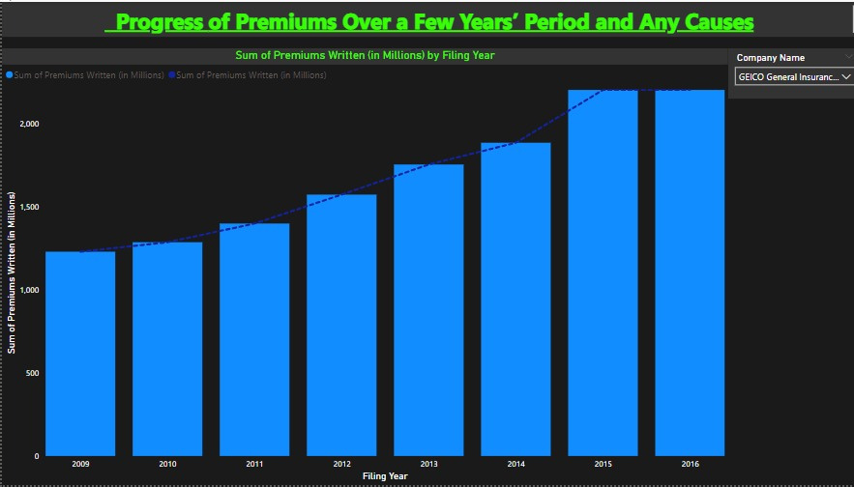
Here is the representation of a company’s progress over the years . GEICO General Insurance Company has grown exponentially and around 2,199.89 million dollars premiums written in 2016.

Slide 10



Causes
An increase in road accidents and unsafe behavior by drivers has led to an increase in the purchase of premiums.
Rising costs of auto repair and medical care contribute to the hike in premiums.
Inflation is another cause of the rise in policy purchases.
Emerging auto technology also resulted in the progress of the automobile insurance industry.

Slide 11

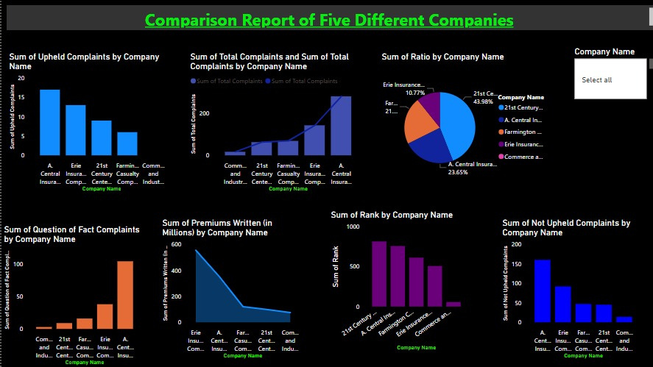

Comparison Report
We have prepared a dashboard that shows a comparison report of five different companies. You can also change the company names to uncover any patterns.

Slide 12








Recommendations
Insurers should maintain transparency in coverage, rights, and complaint processes.
There is a need to ensure that insurance companies comply with consumer protection regulations.
A quick resolution of disputes is also necessary.

Slide 13



THANKYOU
The project helps to understand the insurance market environment and make informed decisions that protect consumer interests within the state.

